Slide 1

PATH FINDING VISUALISATION
SHIVA KOMMAREDDY

Slide 2
What the project is about
The project is all about finding a shortest path between two-given points with obstacles along the way.

Slide 3
How it works
Initially a pop-up is displayed to the user with the options to select two points with the (x, y) co-ordinates.
User also gets an option to show visualization. If the user selects to show visualization then the whole process is showed else the path is showed directly.
This pop-up is displayed using tkinter library.

Slide 4
How it works ….contd
After selecting the points and visualization user clicks on submit then a grid is displayed with the selected points.
User is given option to draw the obstacles between the selected points.
After drawing the obstacles user has to click on spacebar.

Slide 5
How it works ….contd
After spacebar is clicked if the user selects visualization then complete visualization is showed until the path is found.
After spacebar is clicked if the user did not opt for visualization then path is shown.
After the path is found another pop-up is displayed which shows the distance between the two selected points.

Slide 6

Algorithm used
A* algorithm is used.
what is A* algorithm
A* is an informed search algorithm.
It works by maintaining two lists; the open list and the closed list. The open list’s purpose is to hold potential best path nodes that have not yet been considered, starting with the start node. If the open list becomes empty then there is no possible path. The closed list starts out empty and contains all nodes that have already been considered/visited.

Slide 7
Libraries used
Pygame
Tkinter
math

Slide 8
Installing Libraries
If the requires libraries are not present, then user is asked whether to install the required libraries.
If user clicks on y then the required libraries are installed, and the game will start.
If the user clicks on n then an error message is displayed showing an error in the command prompt.

Slide 9
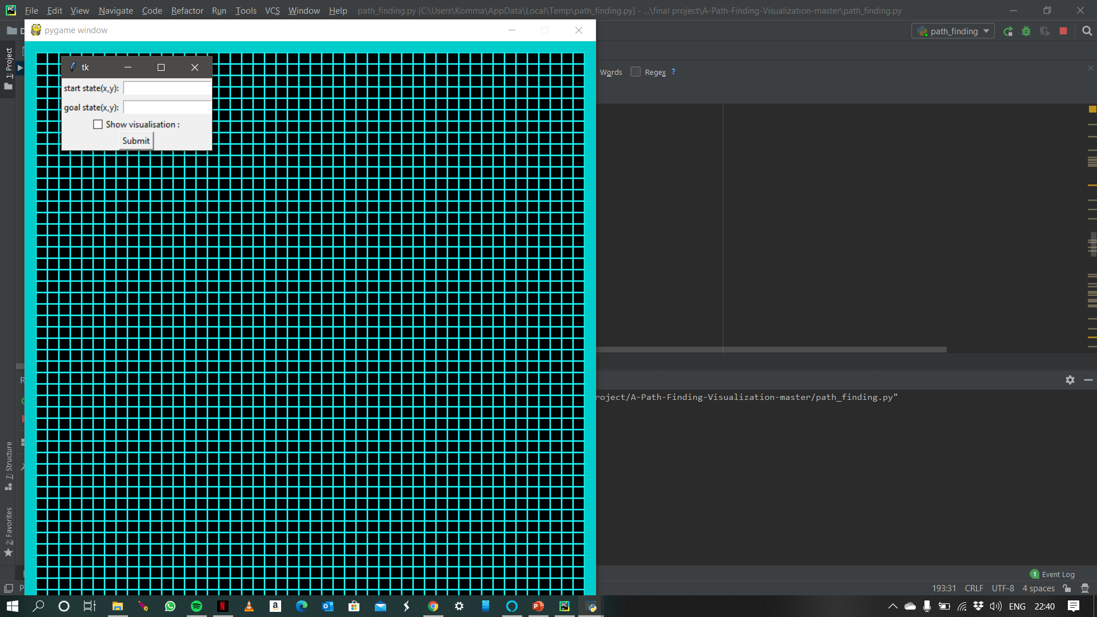
Screenshot 1
Initial pop-up

Slide 10

Screenshot 2
After user entering the values

Slide 11
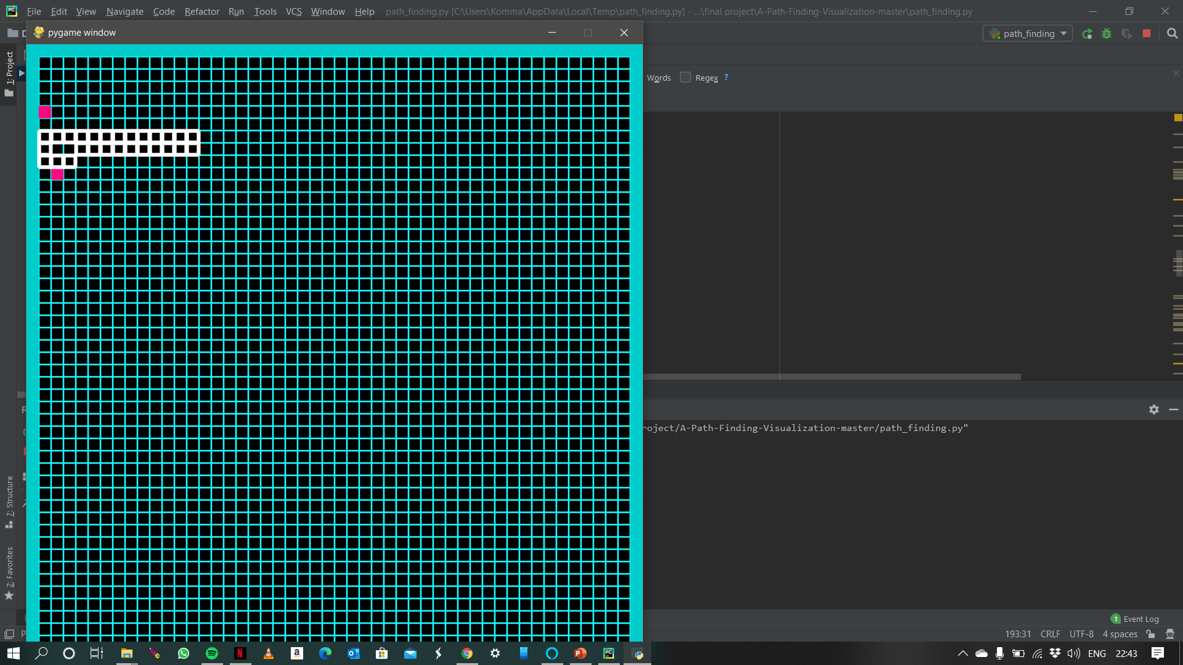
Screenshot 3
After clicking submit the initial and goal states are shown.
User draws the obstacles.

Slide 12
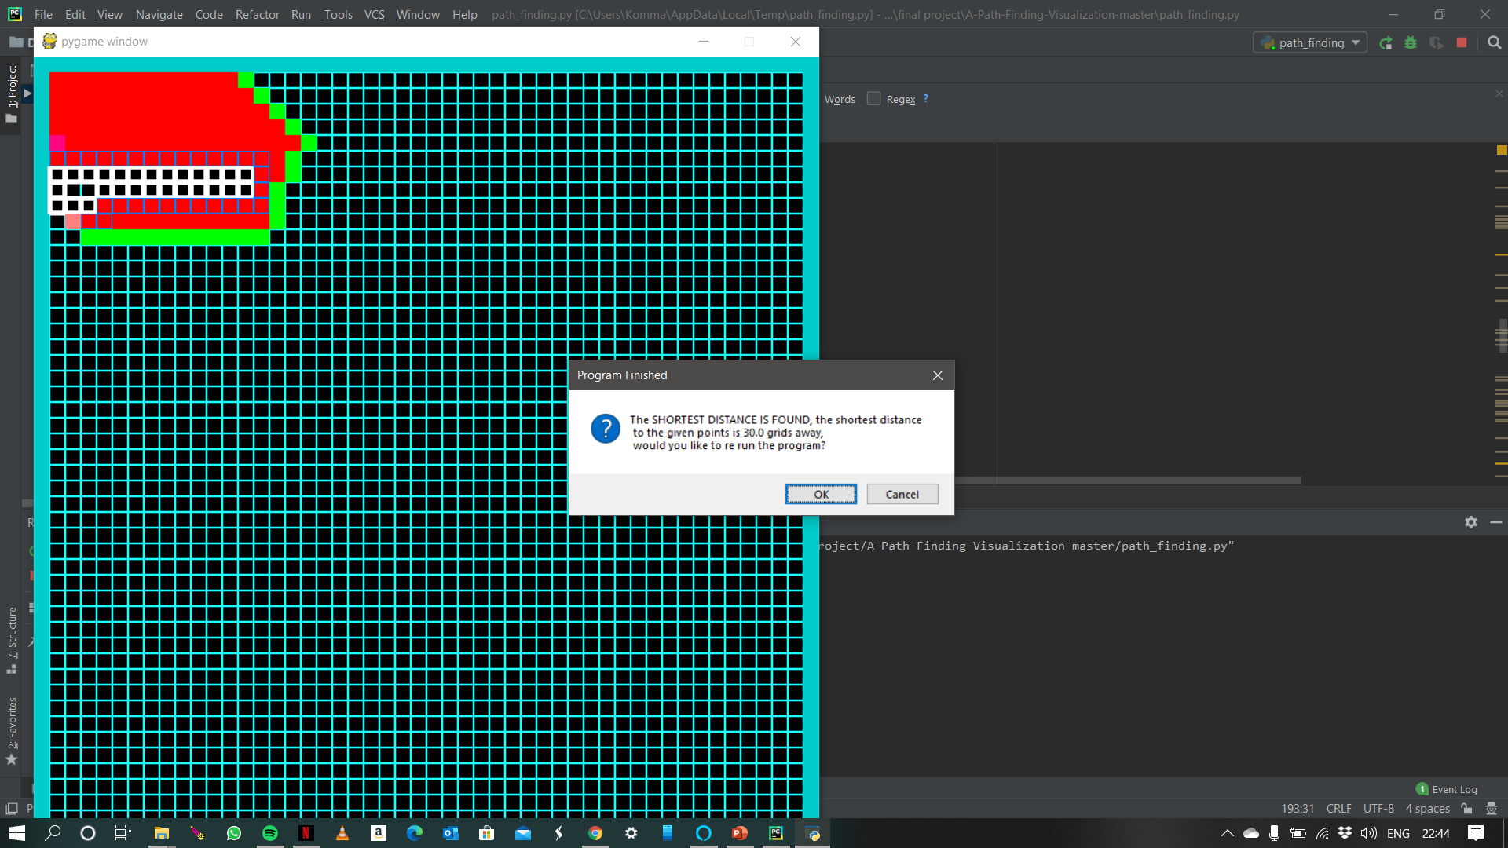
Screenshot 4
As user selected show visualization.

Slide 13

DEMO YOUTUBE LINK: https://youtu.be/nSMqJwcPlEE

Slide 14
CODE
GitHub link : https://github.com/skomm3-unh/aifinalproject.git

Slide 15
THANK YOU

